Slide 1

CLASSROOM ATTENDANCE MANAGEMENT SYSTEM
BY
Rashi Sahu(B15CS031)
Rashmi Sahu(B15CS032)

Slide 2
Requirement Phase
Purpose:
The purpose of this document is to present a detailed description of the Attendance Management System.
It will explain the purpose and features of the system, what the system will do and under what constraints the system will work effectively.
The system’s respond to external stimuli and triggers will be detailed.
This document is for both developers and stakeholders of the Attendance management system.
Key Features :
User Admin Instructor Student
Login Add Course Take Attendance View Attendance
Logout Delete Course View Attendance Choose Courses
View Profile View Courses Update Attendance
Add &Delete Instructor Sent Warning Mail
View Instructor
Add& Delete Student
View Student
Update Instructor Profile

Slide 3
Use Case
Use Case | Add Attendance
Pre Condition | Instructor must be logged in
Basic Path | 1. Instructor choose the option add attendance for a particular course. 2. Instructor choose the option to mark the attendance .
Description
Use Case | Update Attendance
Pre Condition | Instructor must be logged in.
Basic Path | 1. User choose the option update attendance for a particular course . 2.Instructor able to update attendance of a particular student.
Use Case | View Attendance
Pre Condition | Instructor must be logged in.
Basic Path | 1. User choose the option View attendance for a particular course .

Slide 4
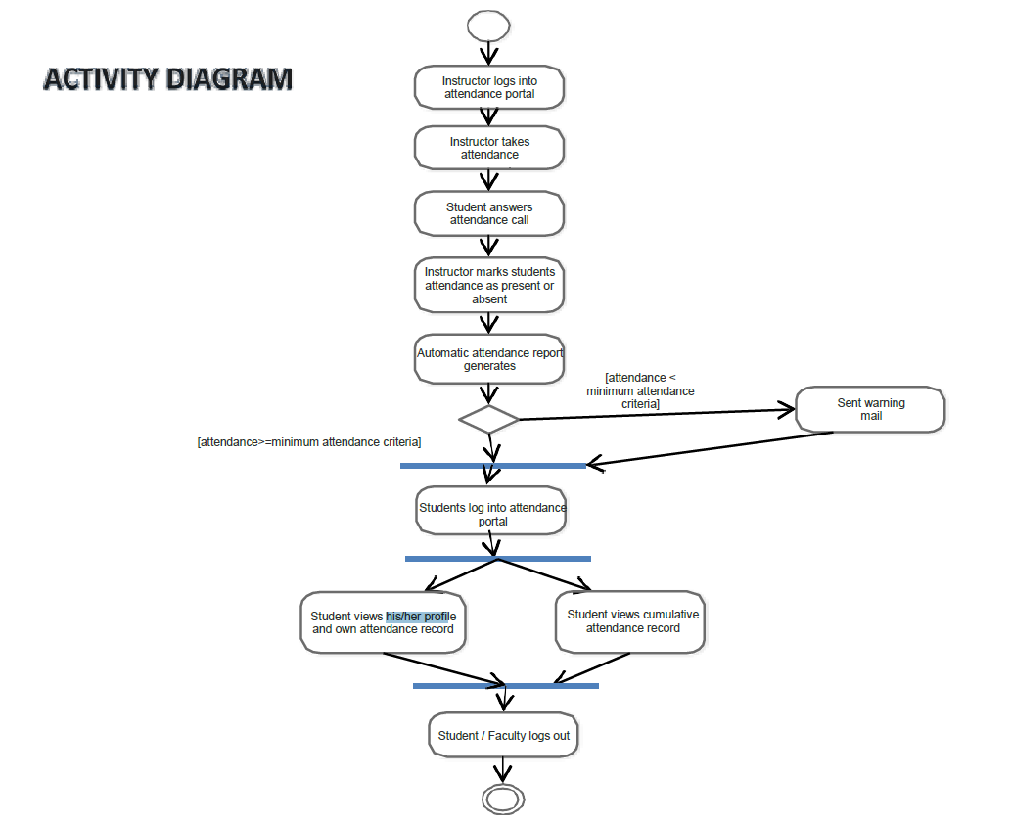
Add Attendance
View Attendance
Design Phase

Slide 5
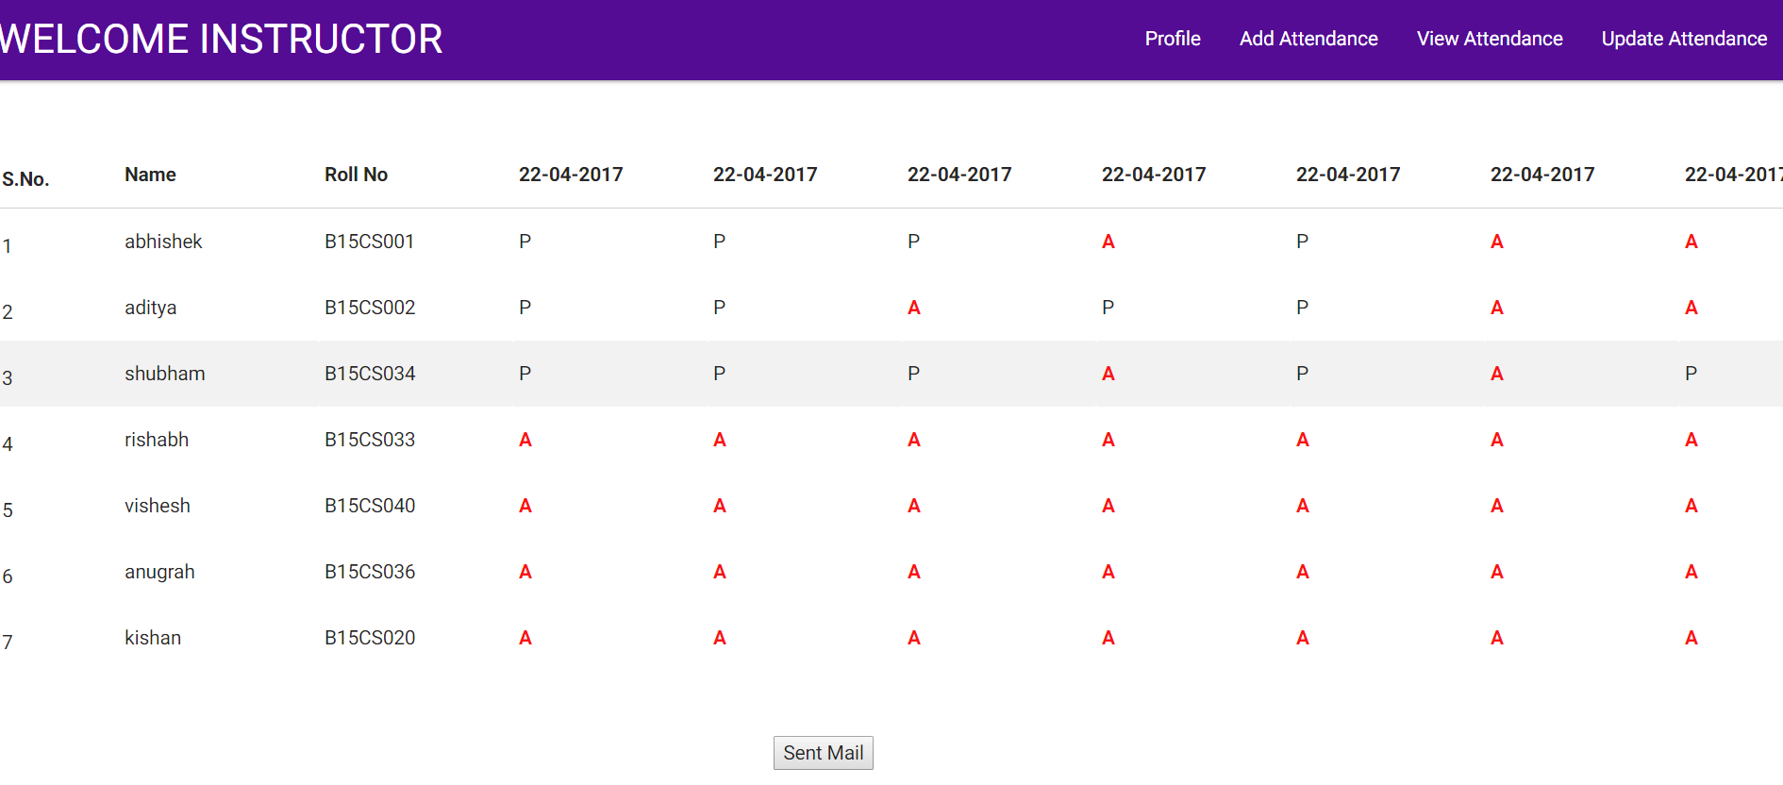
Coding Phase
Language Used For Front end : HTML & CSS
Framework : Materialize CSS
Language Used for Back End : PHP , MySql

Slide 6
Testing Phase
We have tested the Leave Management System and found out given results:
Tests | BUGS
Total Assertions made | 36
Total Assertions Fails | 24
Total Assertions Pass | 12
Total UX Design Bugs | 7

Slide 8
TEST CASE ID | SUMMARY OF DEFECT | RESOLUTION TAKEN
T1.1 | Accepting special characters as a course name | Modify it such that it accepts only characters and numbers as a course name
T1.2 | Accepting more than one instructor for one course | Checked that the course has already taken by one instructor ,if yes then it will not accept another instructor
T1.3 | Accepting roll no. with no proper format | Specified the format of roll no. i.e. starts with “B15
T1.5 | Accepting ambiguous input rather than numeric as a semester number | Specifies the values 1-8 for semester, user has to select any one value
T2.1 | Courses were getting registered any no. of time by a student rather than once. | Resolved by applying the condition that course has already been registered.
T2.3 | Successfully deleted shows when non existing ID is deleted in instructor’s case. | Checked condition for ID is exist or not and showed the error massage.
T3.1 | During login it also accepts the password in uppercase letters in place of lowercase | Resolved it by matching the two strings for password
T3.2 | Accepts the future date as a date of birth | Checked if the entered date of birth is less than current date, if not then it shows an error message
UT4 | Entering wrong information during sign up all input are removed rather than wrong input | Solved by displaying the entered values in the form even if the values are incorrect

Slide 9
THANK YOU
THANK YOU

